Slide 1

Week 2: Prompt Engineering
作者：Alwin Lin

Slide 2
Objectives
Understand key concepts in prompt engineering.
Explore applications of various prompting techniques.
Engage in collaborative problem-solving activities.

Slide 3
Table of context
In Context Learning
Tree of thought
Few shot
Meta prompting
Echo Prompting
Directional stimulus prompting
System Prompts
Retrieval Augmented Generation
Chain of thought
Medprompt

Slide 4
What are LLMs?
Key Components:
Neural Networks: LLMs use deep learning techniques, particularly transformer architectures, which consist of multiple layers (embedding, attention, feedforward).
Training: They are trained on huge datasets using self-supervised learning to recognize patterns and relationships in text.
How Do They Work?
Input Processing: LLMs receive text input and convert it into numerical representations (embeddings).
Context Understanding: Using attention mechanisms, they focus on relevant parts of the input to generate context-aware responses.
Output Generation: The model predicts the next word or phrase based on learned patterns, producing coherent text outputs.

Slide 5

What does it mean for us?
LLMs is effectively a very powerful auto fill machine
Ask the right question, and get the right response.

Slide 6

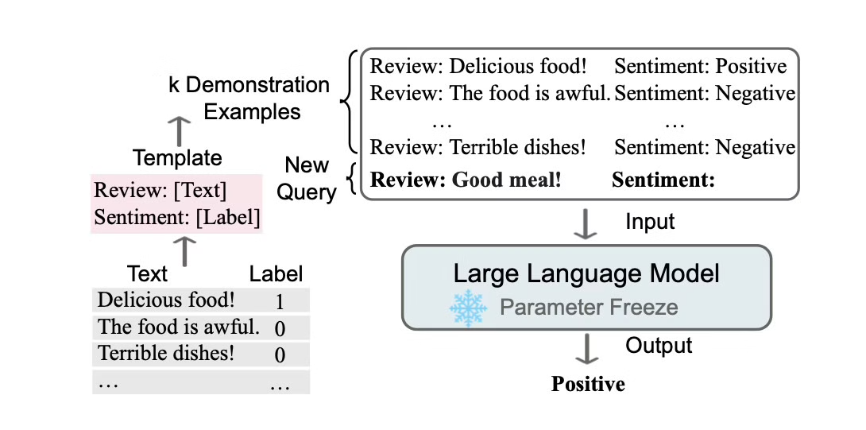
In context learning
A Survey on In-context Learning
Definition:
Providing a prompt without any examples.
Application:
Useful for straightforward queries where context is clear.
Useful for looking up quick facts/articles

Slide 7
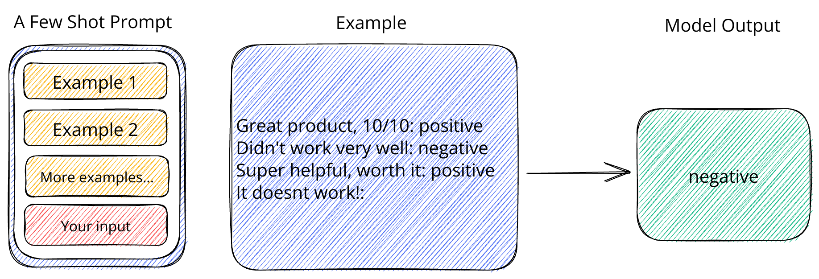
Few shot prompting
Few-Shot: Offering multiple examples for better context.
Use Cases: Enhancing response accuracy in complex tasks.

Slide 8

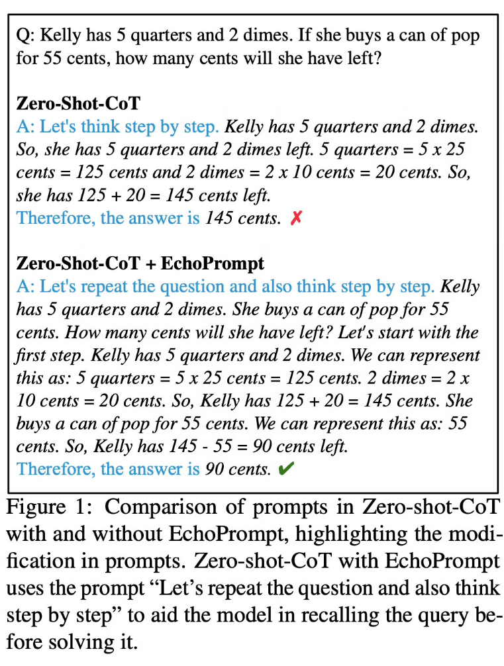
Echo Promping
EchoPrompt: Instructing the Model to Rephrase Queries for Improved In-context Learning
What is it?
Effectively speaking, asking the LLM to rethink a given problem again
How do I use it?
"Let's repeat the question and also think step by step"
"Read the question again"

Slide 9

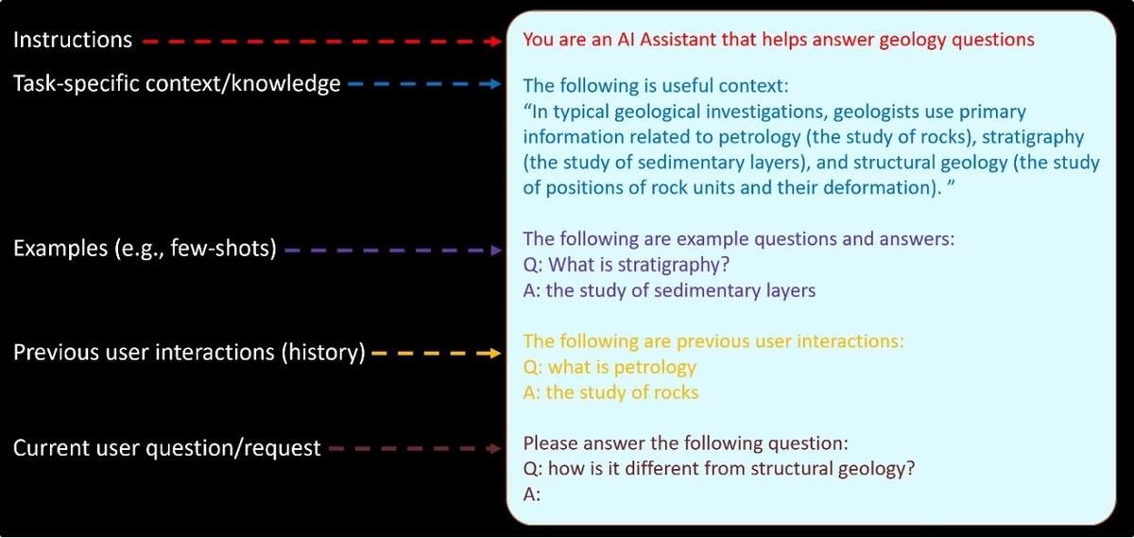
System Instructions
List of System prompts
Why
Using system prompts could lead to more favorable results
Roles could "Stimulate" certain areas of the LLM networks
What does it look like?
You are a friendly AI agent who can provide assistance to the customer regarding their recent order.

Slide 10

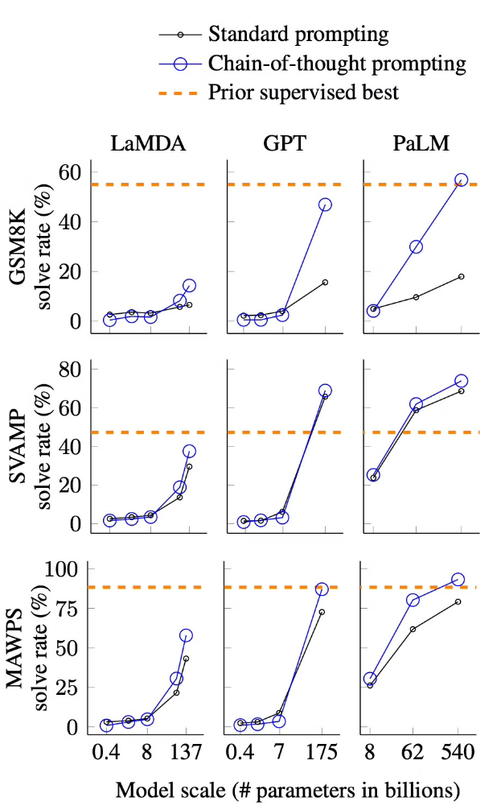
Chain of Thought Prompting
Chain-of-Thought Prompting Elicits Reasoning in Large Language Models
Concept:
Encouraging step-by-step reasoning.
Example:
“Let’s do this step by step.”
Benefits:
Dramatically increases the models' critically thinkig
Example:
Reasoning tokens in GPT 4-o

Slide 11

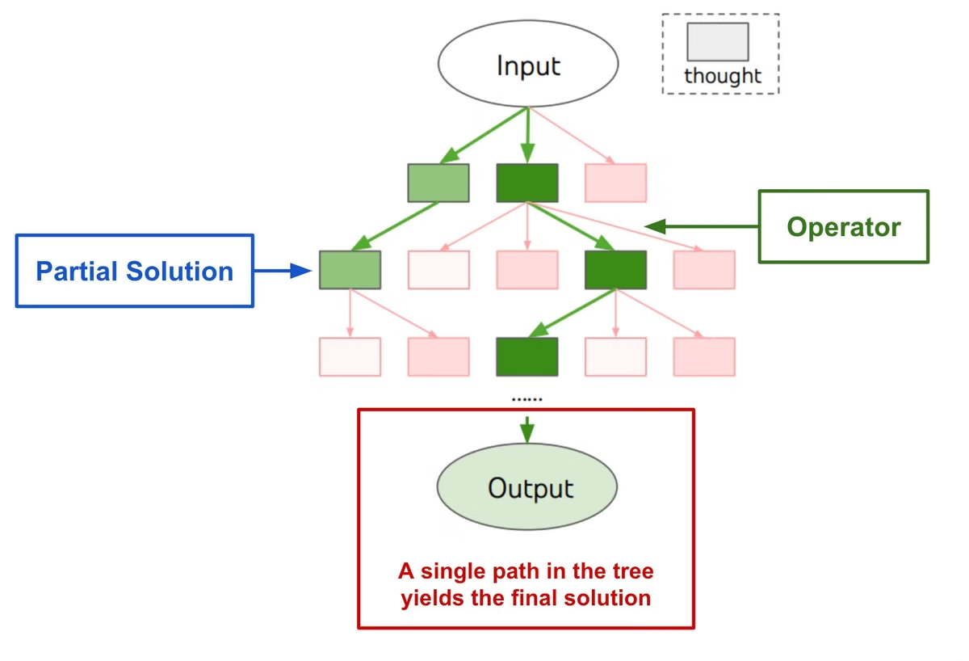
Tree of Thought
Tree of Thoughts: Deliberate Problem Solving with Large Language Models
Structuring reasoning hierarchically.
Extension of Chain of Thought.
Voting systems
Allows systems to back track in conversations

Slide 12

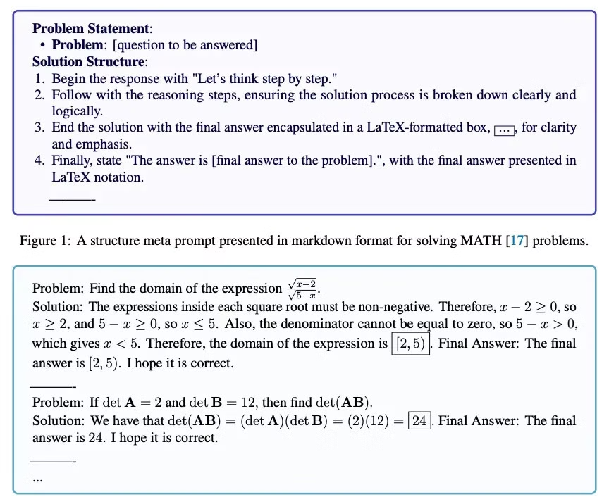
Meta Prompting
Meta Prompting for AI Systems
Definition: Enhancements over few-shot prompting.
Strategy: Effectively instructing the model to achieve desired outcomes.

Slide 13


Large Language Models as Optimizers
Concept:
Using LLMs to optimize outputs through prompting strategies.

Slide 14

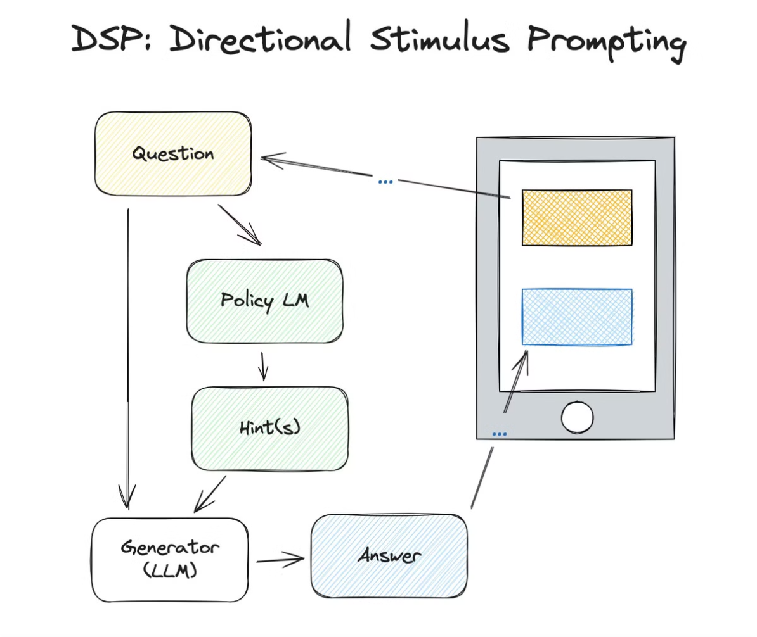
Directional Stimulus Prompting
Guiding Large Language Models via Directional Stimulus Prompting
Concept:
Providing hints to guide AI responses.
Effectively, RAG 0.5
User provided prompts instead of vectors DB
Effective for things that has a clear rubric and require keywords to be present.

Slide 15

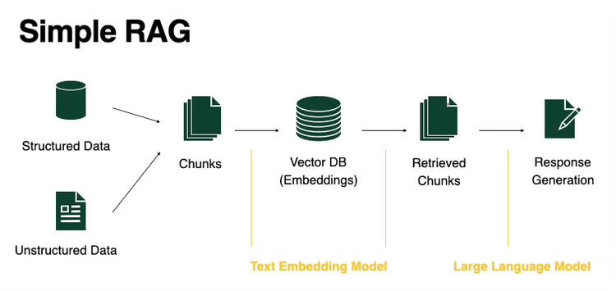
Retrieval-Augmented Generation (RAG)
Retrieval-Augmented Generation for Knowledge-Intensive NLP Tasks
Mechanism:
Information retrieval via vector search.
Limitations in understanding implicit information.

Slide 16

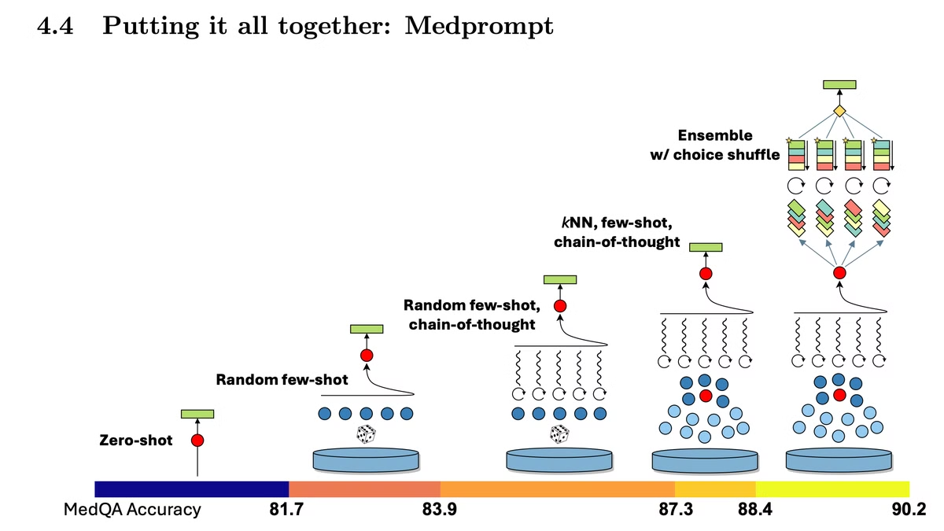
MedPrompt
Can Generalist Foundation Models Outcompete Special-Purpose Tuning? Case Study in Medicine
What is this?
A very token intense method of prompting
Why are we talking about this?
Prompting techniques and methods can mix
One could potentially outperform fine tuned models with enough resource

Slide 17



Now, your turn

Slide 18

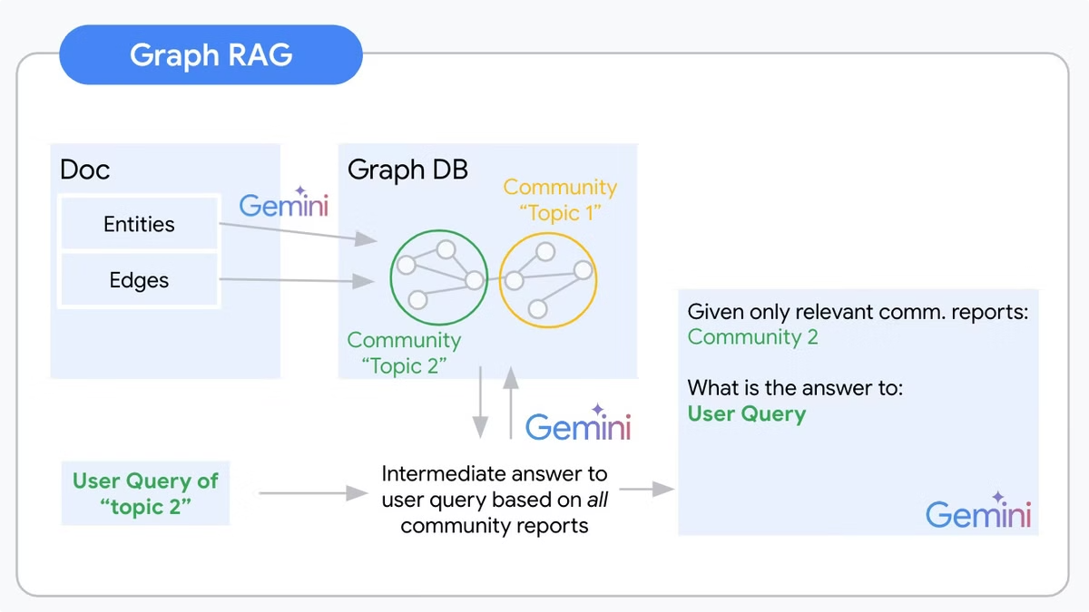
Graph RAG - RM
Benefits:
Capturing insights beyond traditional text analysis.
e.g. Relationships, Groupings, Educations
Issues:
Graphs need to be generated by either LLMs humans

Slide 19

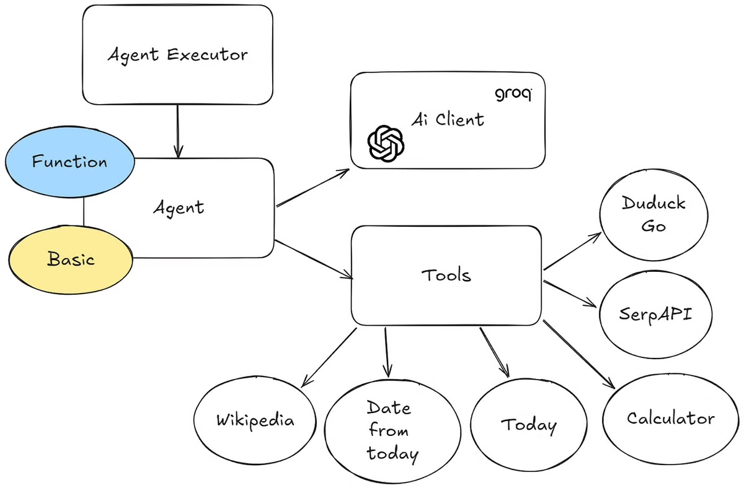
ReAct Agents & Automatic Multi-Step Reasoning and Tool Use - RM
REACT: SYNERGIZING REASONING AND ACTING IN LANGUAGE MODELS & ART: Automatic multi-step reasoning and tool-use for large language models
Capabilities:
Multi step reasoning
Acting
Tool usage
Real-world Impact:
Salesforce pivot to AgentForce
Agent swarms

Slide 20

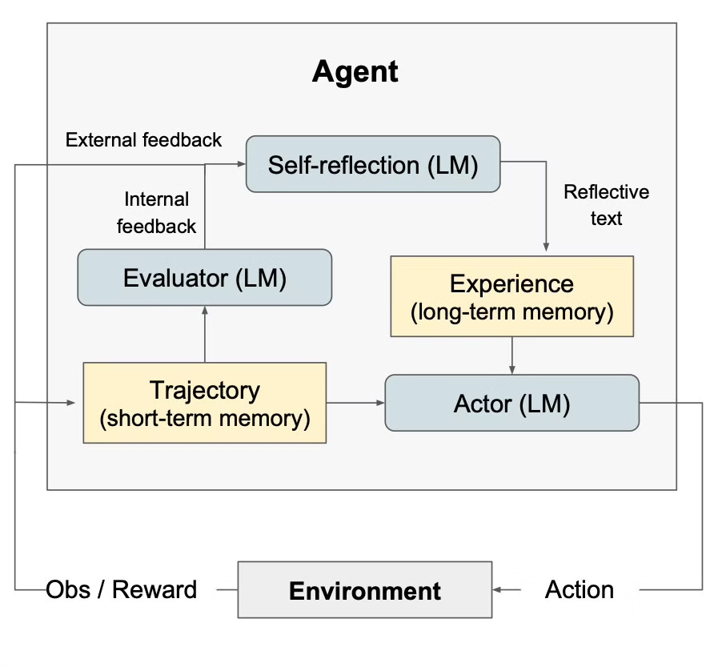
Reflection Techniques -RM
Reflexion: Language Agents with Verbal Reinforcement Learning
Importance of Reflection:
Encourages critical thinking about AI responses.
Prototype of the baby AGI
Issues:
Does lead to loops that can not be automatically resolved

Slide 21

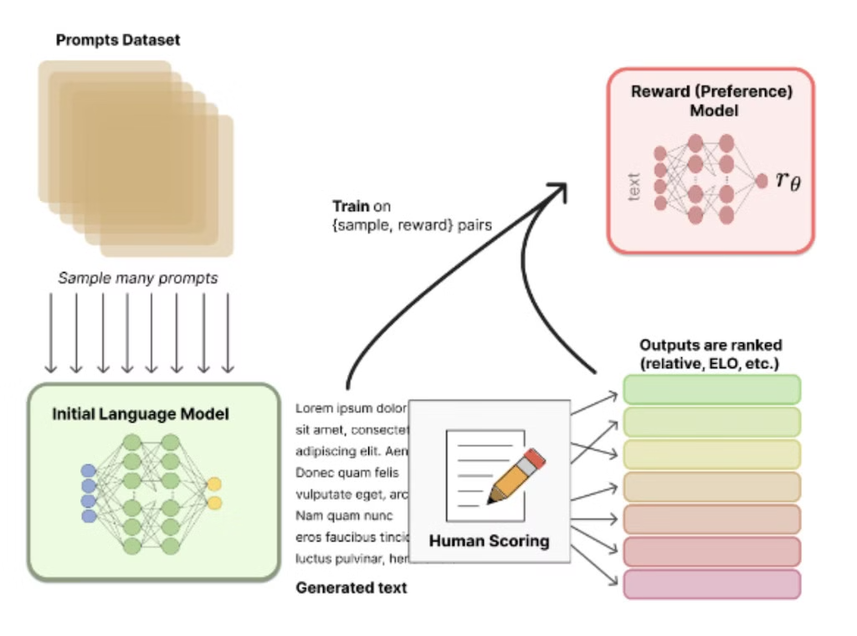
Reinforcement Learning from Human Feedback (RLHF) - RM
Training language models to follow instructions with human feedback
Mechanism:
The "Human in the loop"
Importance:
Aligns model outputs with user preferences.
Applications:
Thumbs up/thumbs down feedback system.
How Google's Gemini got lapped by GPT

